Slide 1




User Experience Engineering
EYE
ZEN
contact@eyezen.com

Slide 2
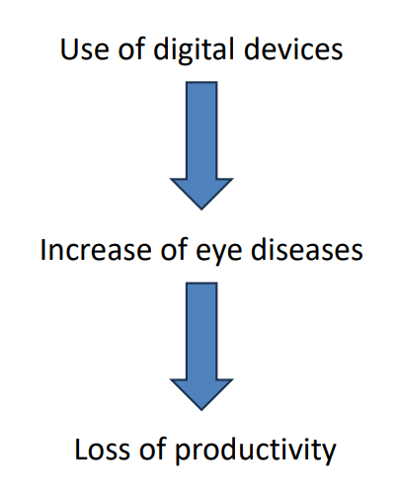
PROBLEM IDENFICATION

Slide 3


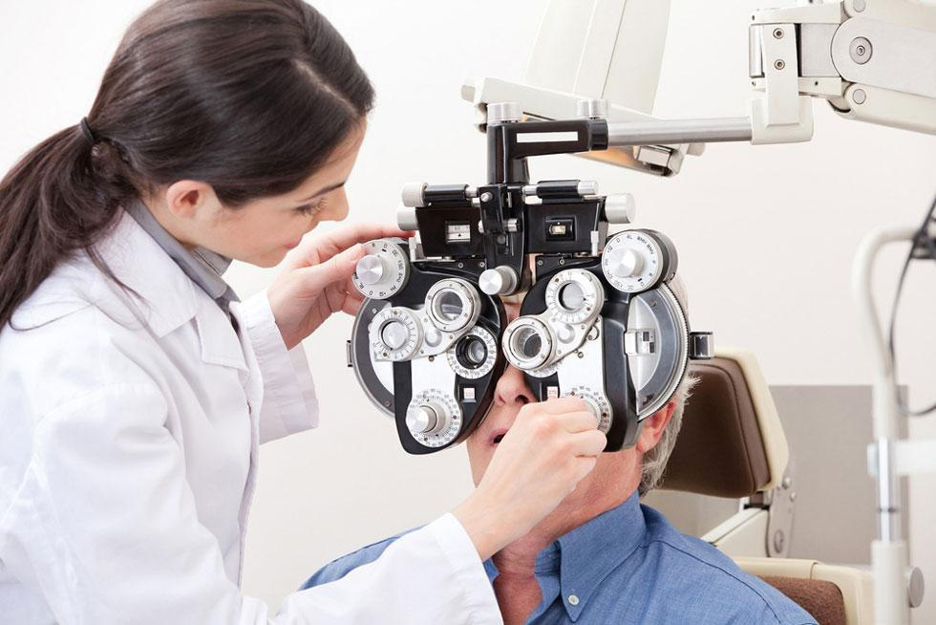
STATISTICS
“Globally, at least 2.2 billion people have a near or distance vision impairment. In at least 1 billion of these, vision impairment could have been prevented or is yet to be addressed.” “Vision impairment poses an enormous global financial burden, with the annual global cost of productivity estimated to be US$ 411 billion”
EYE
ZEN

Slide 4

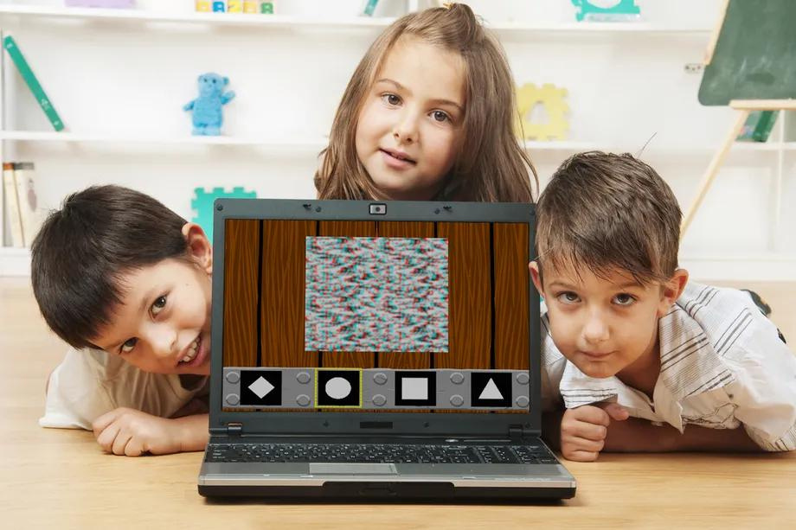
OUR MISSION
To revolutionize eye care through innovative technology, making early detection and holistic eye health accessible to all.
EYE
ZEN

Slide 5
SWOT ANALYSIS
EYE
ZEN
Strengths
Weaknesses
Cutting-edge mobile app for comprehensive eye care. Integration of traditional and modern treatments. User-friendly interface for all age groups.
Limited testing for myopia due to practical constraints. Initial need for awareness building.
Opportunities
Threats
Expanding vision tests and eye exercises. Potential in telehealth for eye care.
Competition from established eye care providers.

Slide 6

MARKET GAPS
EYE
ZEN
Existing Competitive Products
ICARE Vision Test
Vision Care App
BabySparks
Vision
Color Vision Test
Color test
Gaps in the Current Market
Mainly Targets on Adults
Early Detection of infants
Combining Indigenous and western Treatments
User Friendly Interface

Slide 7
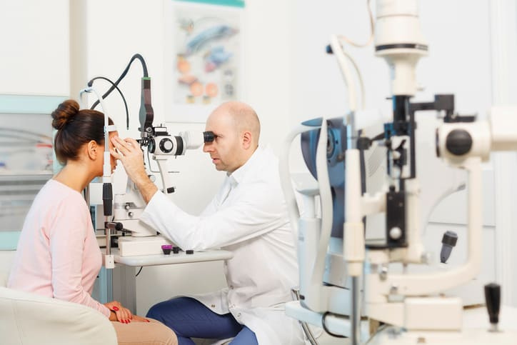
TARGET AUDIENCE
EYE
ZEN
Age Group: Individuals of all age groups, from Infants to seniors
Urban and Rural Users
Health-Conscious Individuals: Individuals with a proactive approach to health and wellness.

Slide 8
STRATEGY
Combine innovative diagnostics with holistic treatments.
Expand features based on user feedback.
Collaborate with eye care specialists for expert input.
Create a scalable and adaptable platform.
EYE
ZEN

Slide 9
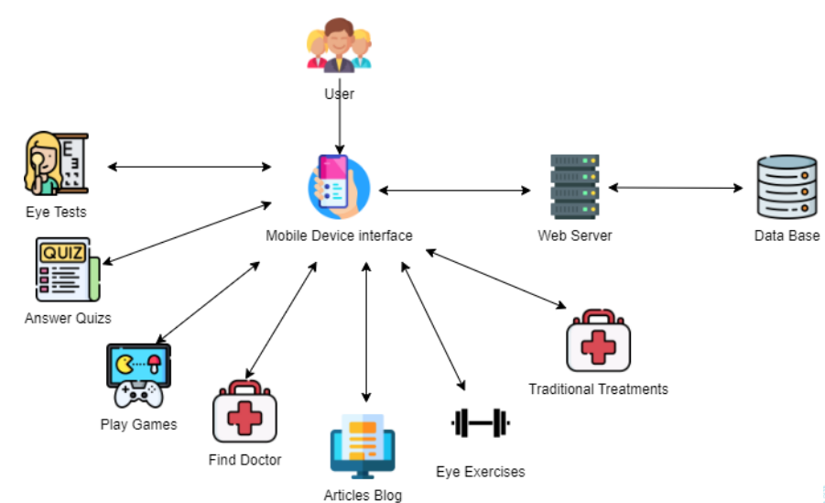
SYSTEM OVERVIEW

Slide 10
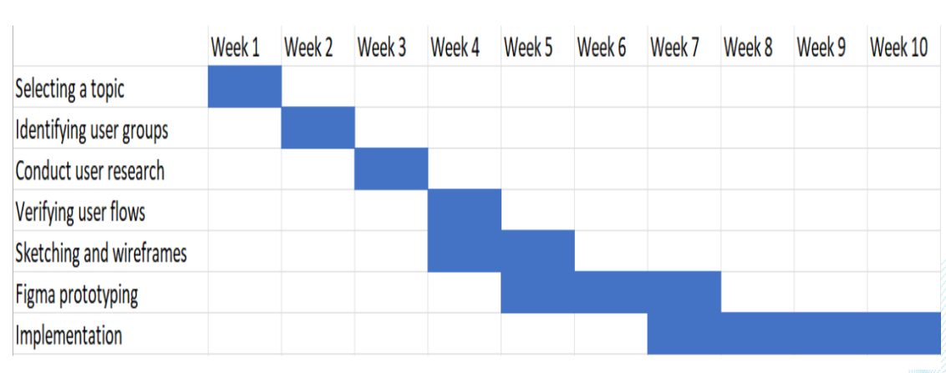
TIMELINE
EYE
ZEN

Slide 11
FINANCE
INITIAL INVESTMENT: 220, 000/=
REVENUE PROJECTIONS:
YEAR 1 - 100,000/=
YEAR 2 – 250,000/=
YEAR 3 – 500,000/=
EYE
ZEN

Slide 12
COST ANALYSIS
PLANNING AND DESIGNING STAGE COST – 20,000
IMPLEMENTATION COST – 100,000
TESTING COST – 50,000
MARKETING COST – 50,000
EYE
ZEN

Slide 13
COMMERCIALIZATION
FREEMIUM MODEL : ADD ADITIONAL PREMIUM FEATURES.
DATA INSIGHTS AND ANALYTICS: ANONYMIZED DATA FROM USERS' QUIZ RESPONSES AND EYE TESTS AND CREATE VALUABLE INSIGHT WHICH HAS ECONOMIC VALUE.
AYURVEDIC ITEMS (IF POSSIBLE)
ADVERTISING : AD REVENUE CAN BE GENERATED BASED ON THE NUMBER OF IMPRESSIONS OR CLICKS ON THESE ADVERTISEMENTS.
PARTNERSHIPS WITH EYE CARE SPECIALISTS : COLLABORATING WITH EYE CARE SPECIALISTS AND CLINICS TO RECOMMEND THEIR SERVICES.

Slide 14
ATTRACTIVE POINTS FOR INVESTORS
Why Choose EyeZen?
The unique combination of technology and traditional treatments.
Expanding market in the digital health sector.
Proven commitment to user feedback and continuous improvement.
A talented and experienced team.

Slide 15
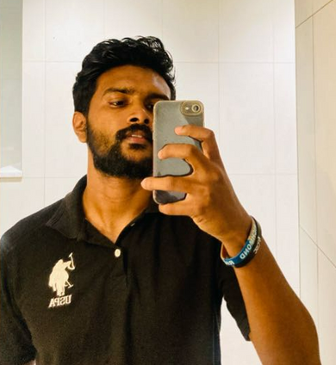


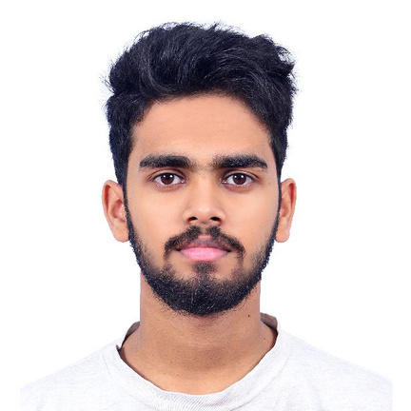
OUR TEAM
EYE
ZEN
Ishara Madusanka
Umesha Silva
Isuru Madusanka
Yasiru Karunarathne
User Experience Engineering

Slide 16
THANK YOU!
User Experience Engineering

